Slide 1
Fundamentals of
Electric Circuits
2020.6
Chapter14
Frequency Response

Slide 2
Chapter14 Frequency Response
14.1 Introduction
14.2 Transfer Function
14.5 Series Resonance
14.6 Parallel Resonance
13.7 Passive Filters
13.8 Active Filters

Slide 3

14.1 Introduction
In our sinusoidal circuit analysis, we have learned how to find voltages and currents in a circuit with a constant frequency source. If we let the amplitude of the sinusoidal source remain constant and vary the frequency, we obtain the circuit’s frequency response.

Slide 4
14.1 Introduction
The sinusoidal steady-state frequency responses of circuits are of significance in many applications, especially in communications and control systems.
A specific application is in electric filters that block out or eliminate signals with unwanted frequencies and pass signals of the desired frequencies.
Filters are used in radio, TV, and telephone systems to separate one broadcast frequency from another.

Slide 5
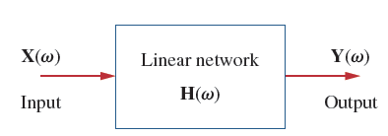
14.2 Transfer Function
The transfer function H(ω)(also called the network function) is a useful analytical tool for finding the frequency response of a circuit.
A transfer function is the frequency-dependent ratio of a forced function to a forcing function (or of an output to an input).

Slide 6
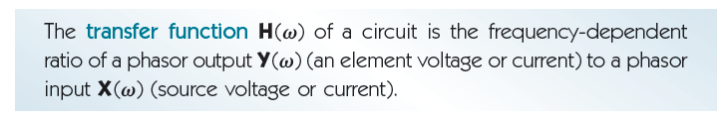
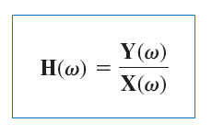
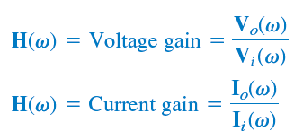
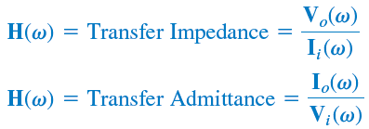


Slide 7
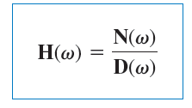
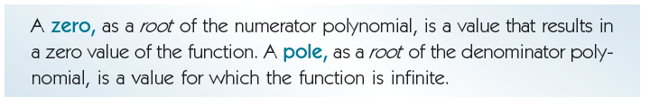

The roots of N(ω)=0 are called the zeros of H(ω) and are usually represented as jω= z₁, z₂,…
Similarly, the roots of D(ω)=0 are the poles of D(ω) and are represented as jω=p₁, p₂, …..

Slide 8

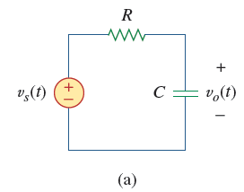
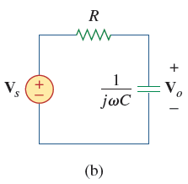




Slide 9
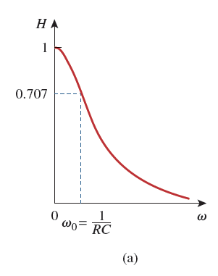
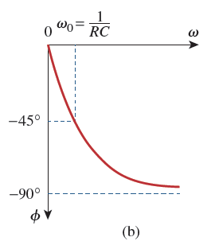
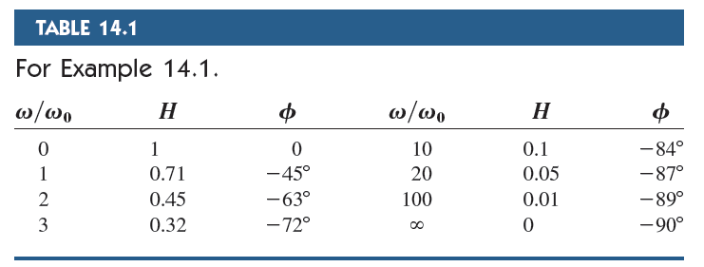

Slide 10

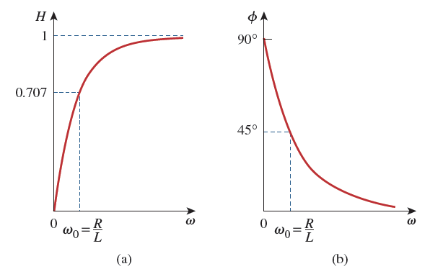
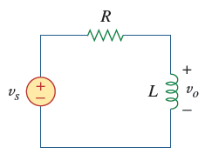


Slide 11

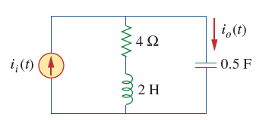
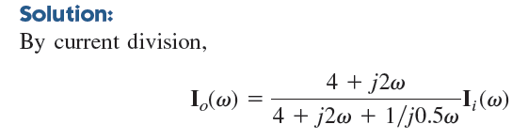






Slide 12
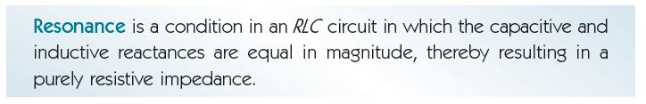
14.5 Series Resonance
The most prominent feature of the frequency response of a circuit may be the sharp peak (or resonant peak) exhibited in its amplitude characteristic.
Resonance occurs in any circuit that has at least one inductor and one capacitor.
Resonant circuits (series or parallel) are useful for constructing filters, as their transfer functions can be highly frequency selective. They are used in many applications such as selecting the desired stations in radio and TV receivers.

Slide 13
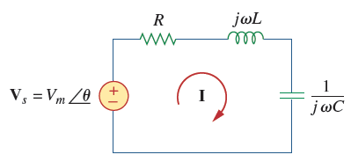


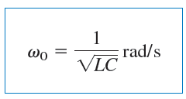


Consider the series RLC circuit shown in the frequency domain.
Resonance results when the imaginary part of the transfer function is zero.
The value of ω that satisfies this condition is called the resonant frequency ω₀

Slide 14






Slide 15
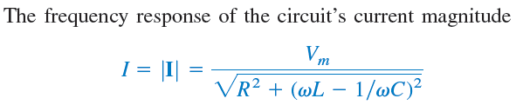
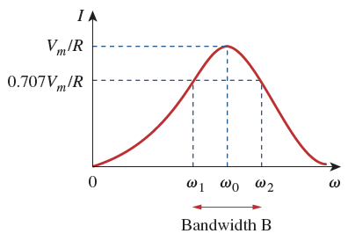




Slide 16
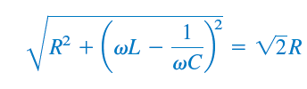
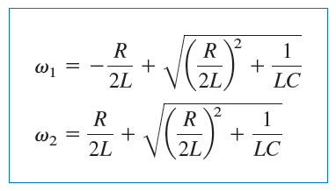
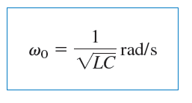

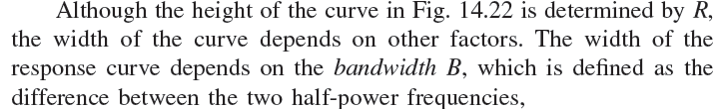


Slide 17

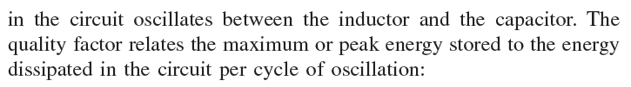
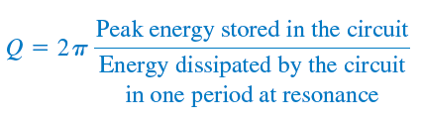

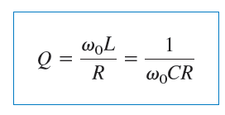
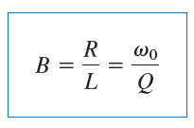


Slide 18
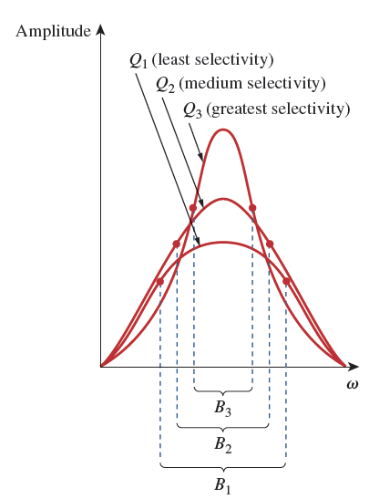


The higher the value of Q, the more selective the circuit is but the smaller the bandwidth.
The selectivity of an RLC circuit is the ability of the circuit to respond to a certain frequency and discriminate against all other frequencies.

Slide 19
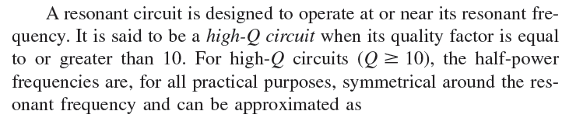
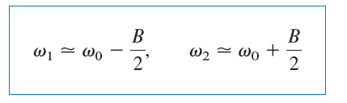

Slide 20
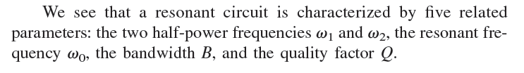


Slide 21

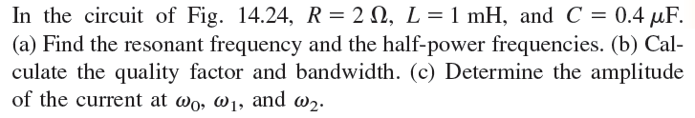
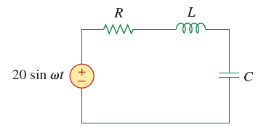


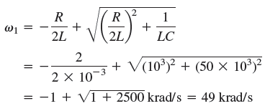






Slide 22


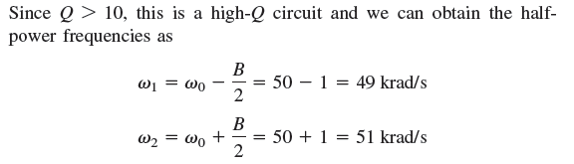



Slide 23
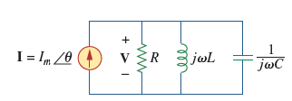



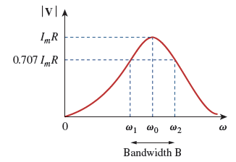
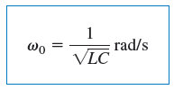
14.6 Parallel Resonance

Slide 24


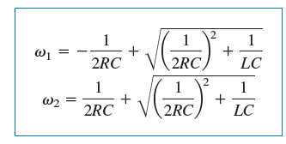
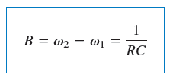

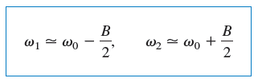

14.6 Parallel Resonance

Slide 25
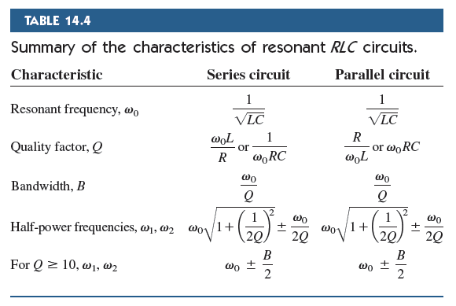

Slide 26

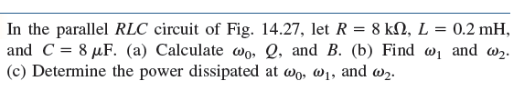
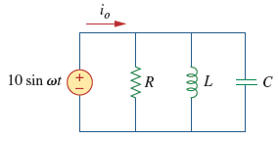




Slide 27
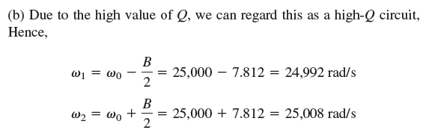

Slide 28
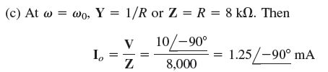
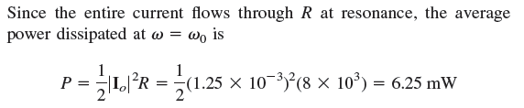



Slide 29

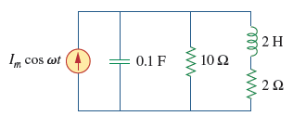




Slide 30
Chapter14 Frequency Response

Slide 31
series RLC circuit

Slide 32
Parallel RLC circuit

Slide 33



14.7 Passive Filters

Slide 34




There are four types of filters whether passive or active:
1. A lowpass filter passes low frequencies and stops high frequencies.
2. A highpass filter passes high frequencies and rejects low frequencies.
3. A bandpass filter passes frequencies within a frequency band and blocks or attenuates frequencies outside the band.
4. A bandstop filter passes frequencies outside a frequency band and
blocks or attenuates frequencies within the band.

Slide 35

lowpass filter
highpass filter
bandpass filter
bandstop filter

Slide 36








14.7.1 Lowpass Filter
A typical lowpass filter is formed when the output of an RC circuit is taken off the capacitor.
cutoff frequency
(rolloff frequency)

Slide 37







14.7.2 Highpass Filter
A highpass filter is formed when the output of an RC circuit is taken off the resistor.

Slide 38





14.7.3 Bandpass Filter
The RLC series resonant circuit provides a bandpass filter when the output is taken off the resistor.

Slide 39






14.7.4 Bandstop Filter
A bandstop filter is formed when the output RLC series resonant circuit is taken off the LC series combination.

Slide 40
14.8 Active Filters
There are three major limitations to the passive filters considered in the previous section.
First, they cannot generate gain greater than 1; passive
elements cannot add energy to the network.
Second, they may require bulky and expensive inductors.
Third, they perform poorly at frequencies below the audio frequency range (300 Hz < f < 3,000 Hz).
Nevertheless, passive filters are useful at high frequencies.

Slide 41
14.8 Active Filters
Active filters consist of combinations of resistors, capacitors, and op amps. They offer some advantages over passive RLC filters.
First, they are often smaller and less expensive, because they do not require inductors. This makes feasible the integrated circuit realizations of filters.
Second, they can provide amplifier gain in addition to providing the same frequency response as RLC filters.
Third, active filters can be combined with buffer amplifiers (voltage followers) to isolate each stage of the filter from source and load impedance effects.
However, active filters are less reliable and less stable.
The practical limit of most active filters is about 100 kHz-most active filters operate well below that frequency.

Slide 42






14.8.1 First-Order Lowpass Filter
The components selected for Z_{i} and Z_{f} determine whether the filter is lowpass or highpass, but one of the components must be reactive.

Slide 43




14.8.2 First-Order Highpass Filter

Slide 44







14.8.3 Bandpass Filter

Slide 45




14.8.4 Bandreject Filter
A bandreject filter may be constructed by parallel combination of a lowpass filter and a highpass filter and a summing amplifier

Slide 46


Summary and Review

Slide 47



Slide 48
Assignment (page 667)
Problems 14.30, 14.34, 14.40, 13.45,

